Slide 1
The Yangtze River in China
By: Alexandria Short

Slide 2
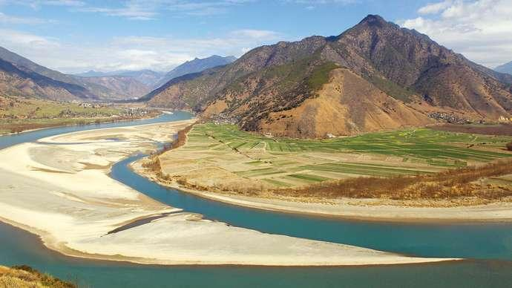
Notes:
Here is a photo of the river *image source Britannica.

Slide 3
Background and water quality issues
This is the longest river in both China and Asia and, the third longest river in the world, with a length of 3,915 miles (6,300 km).
The Yangtze is the most important river of China. It is the country’s principal waterway, and its basin is China’s great granary and contains nearly one-third of the national population.
The Yangtze basin contributes nearly half of China’s crop production, including more than two-thirds of the total volume of rice.

Slide 4
The biggest problem on the Yangtze, is the Three Gorges Dam.
The dam has lead to horrible consequences such as: earthquakes, landslides, flooding, pollution and species endangerment,
The dam is located on a fault, and scientists believe this is triggering earth quakes.
The construction of the dam has also displaced, the people living in the cities close to the dam.
The pollution and flooding associated with the dam puts a negative impact on plant and fish species.
The dam has also contributed to drought.

Slide 5
The region is known to support 378 species of fish, more than 280 species of mammals, 145 species of amphibians, and 166 species of reptiles.
”Yangtze region is home to more than 400 million people, or nearly one-third of China’s population. Some of China’s largest cities—Chengdu, Chongqing, Wuhan, Nanjing, and Shanghai—are all located in the plains that adjoin the banks of the Yangtze River and its tributaries in the basin.
”Poorly planned hydrological engineering and other construction projects that interrupt the natural water flow have degraded and destroyed ecosystems and driven species out of their natural homes.”

Slide 6
Cultural attitudes towards the Yangtze
The Yangtze River is very important to China since it is a great part of their history, culture, and economy.
Yangtze has been used for water, irrigation, sanitation, transportation, industry, boundary-marking and war for thousands of years now”.
The river is also responsible for supplying 40% of the country's GDP. Almost half of the country’s economy depends on the Yangtze River, such as the basin where they are focused on agriculture production.

Slide 7
Commercial uses of the river include agriculture, forestry, fishing, flood control, land reclamation, and tourism.
Environmental problems include deforestation, desertification, soil erosion (especially in the upper and middle sections), increased runoff in floodplains, water pollution from sewage and industrial waste, reduction of lake and wetland areas,high sediment load and siltation, and exhaustionof fish resources.
Poverty in some areas, and dependence on livestock and fuelwood, with few viable economic alternatives, has contributed to unsustainable use of resources.

Slide 8
Conclusion
“The Three Gorges Dam on the Chang Jiang (Yangtze River) is the largest dam and largest electricity generating facility in the world. The project was designed to control floods, ease navigation, and provide needed electricity for China's heartland.”
The construction of the three gorges dam has led to devastating environmental effects.
The river has a major cultural, economical, and historical significance .

